Slide 1

Exploratory Data Analysis on
Exploratory Data Analysis on Smart Watch Health Data
Smart Watch Health Data
Na Zhou
6252-ITDS-1471-Data Analysis using Python-SS-19631
4/29/2025

Slide 2
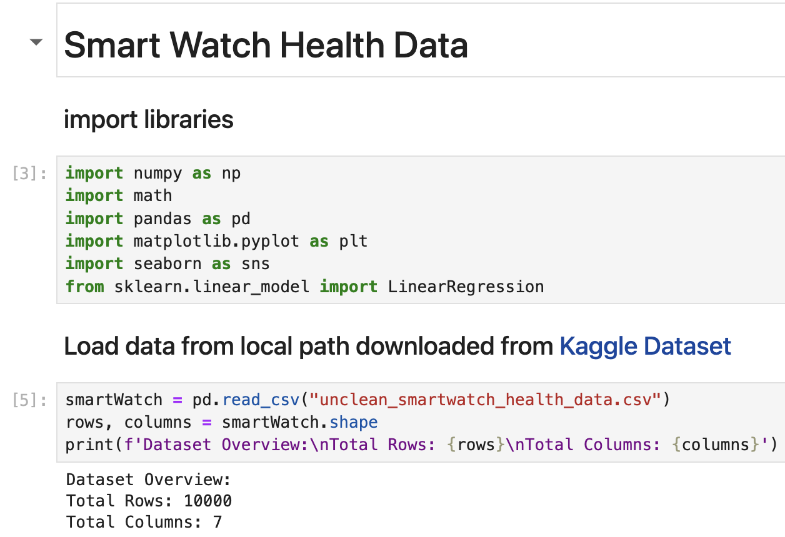
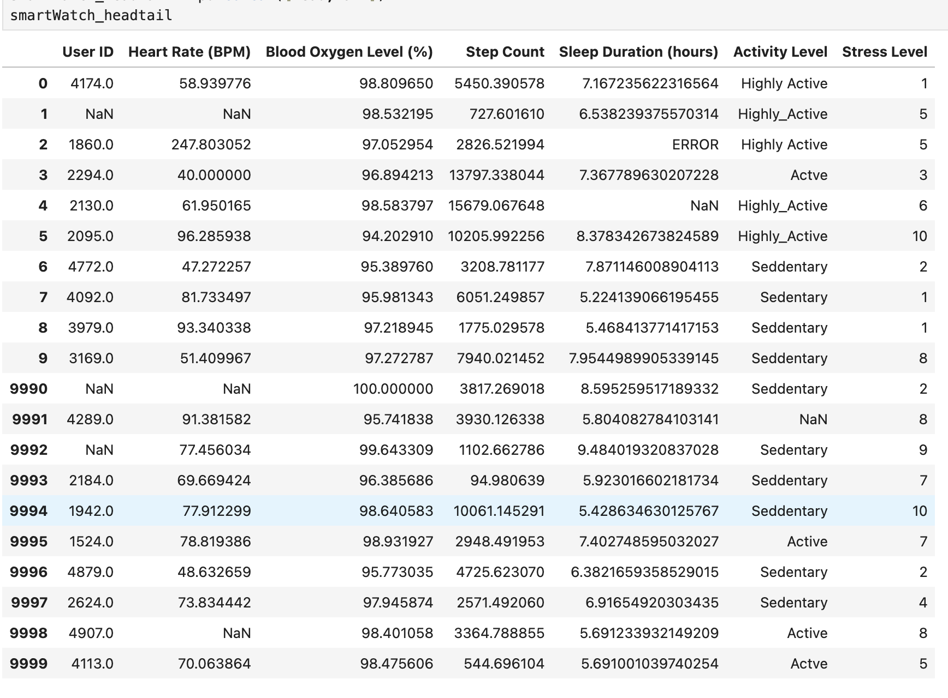
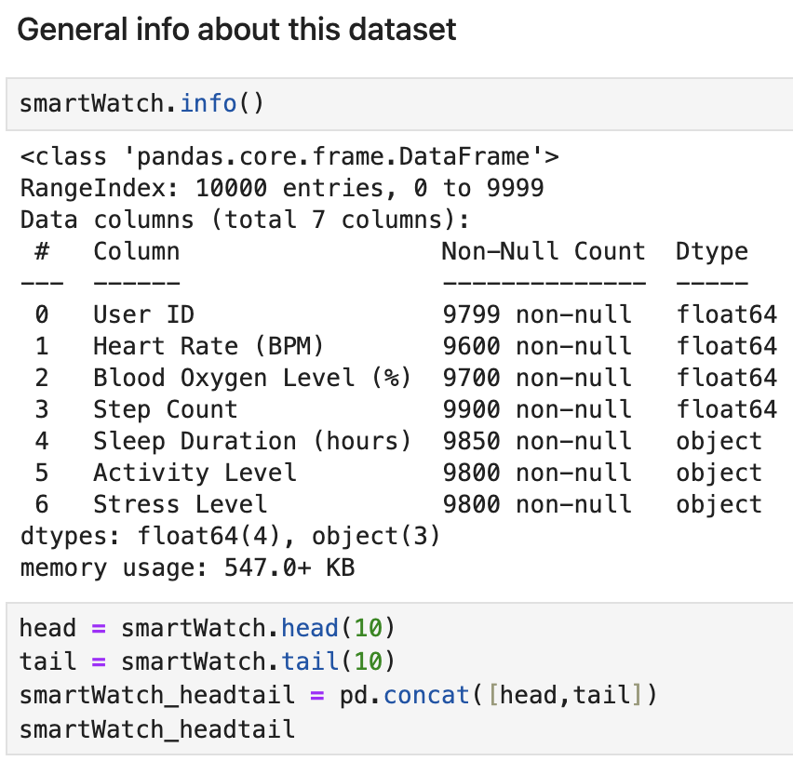
Data Inspection

Slide 3
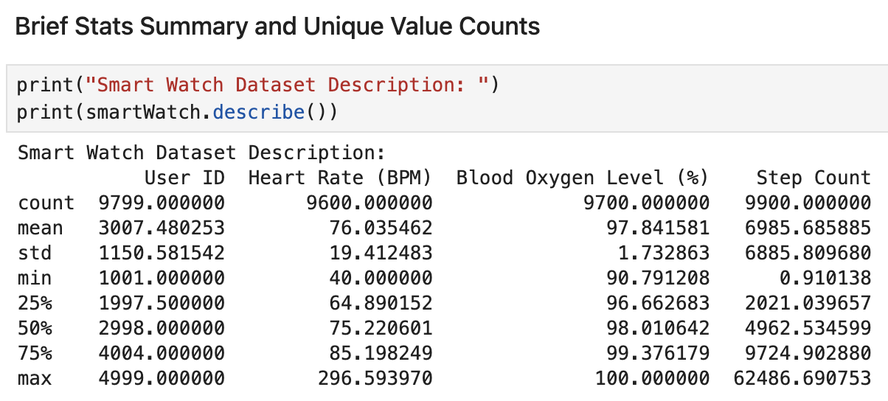
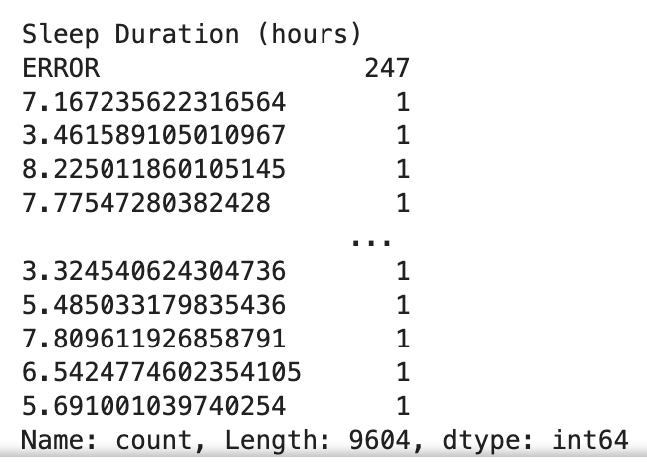
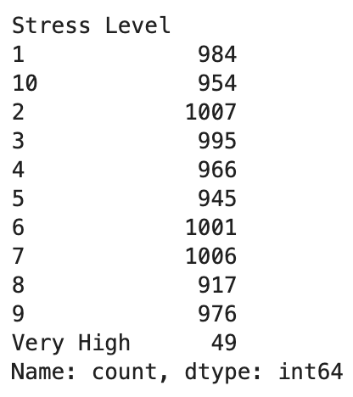
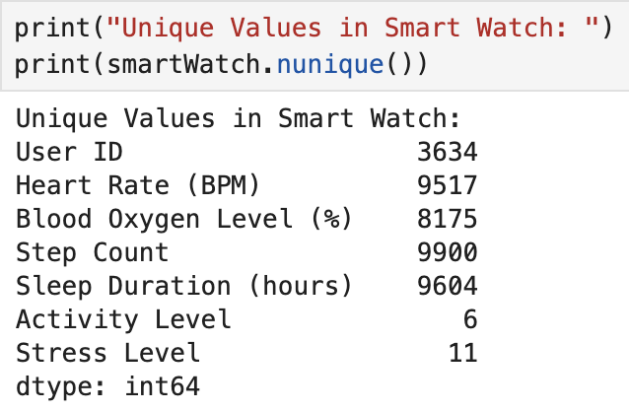
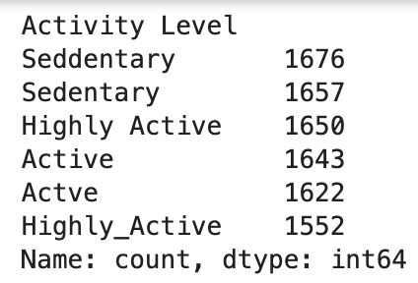
Data Inspection

Slide 4
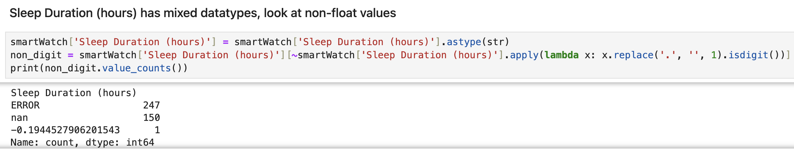
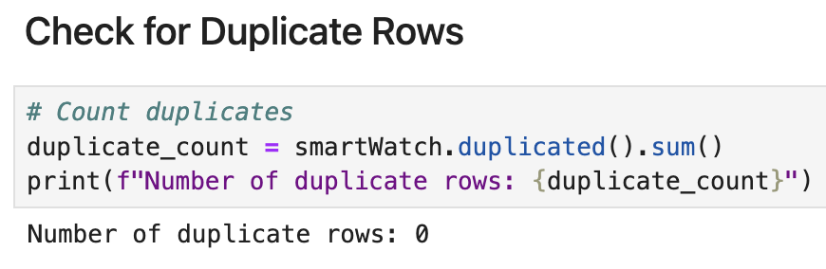
Data Inspection

Slide 5
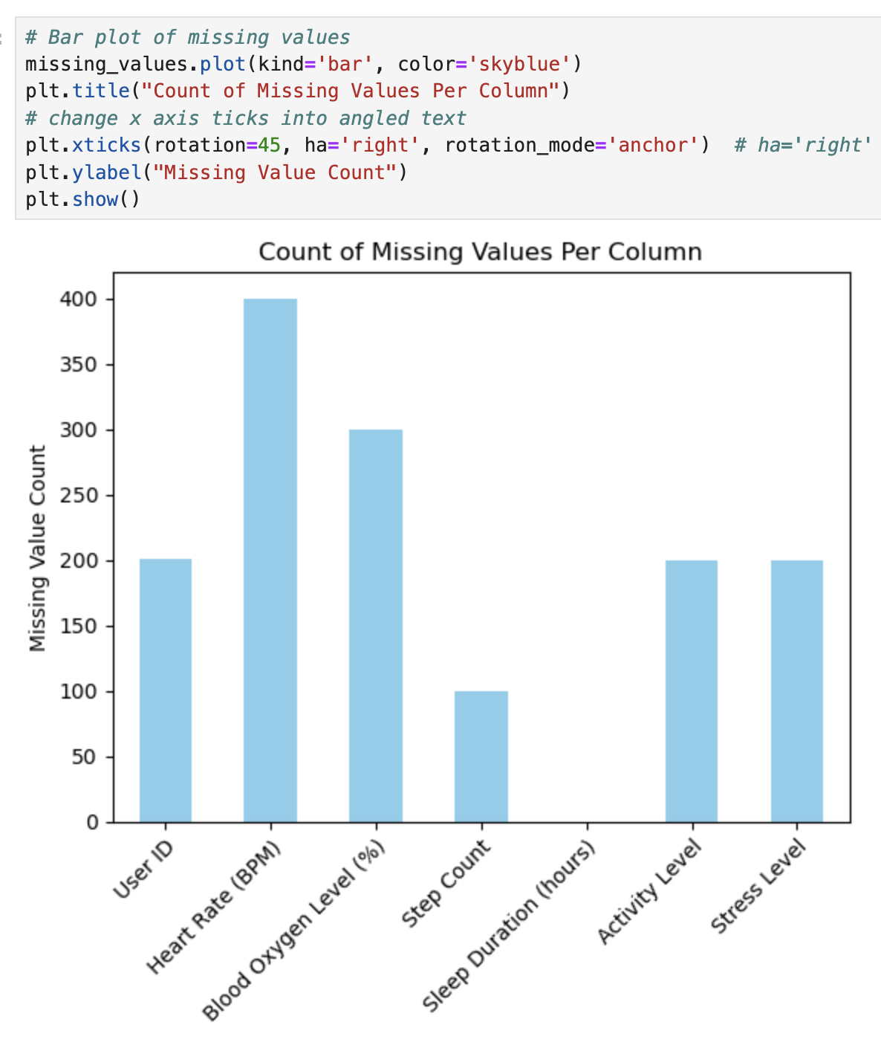
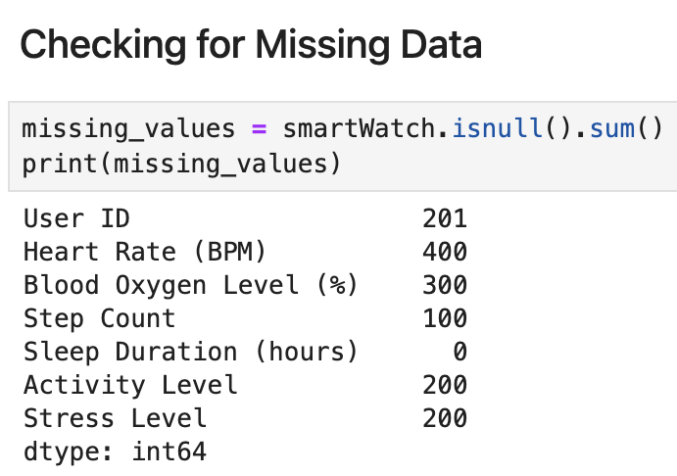
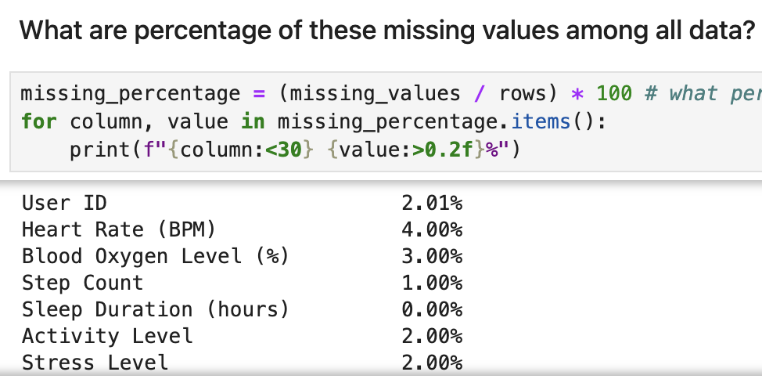
Missing Value

Slide 6
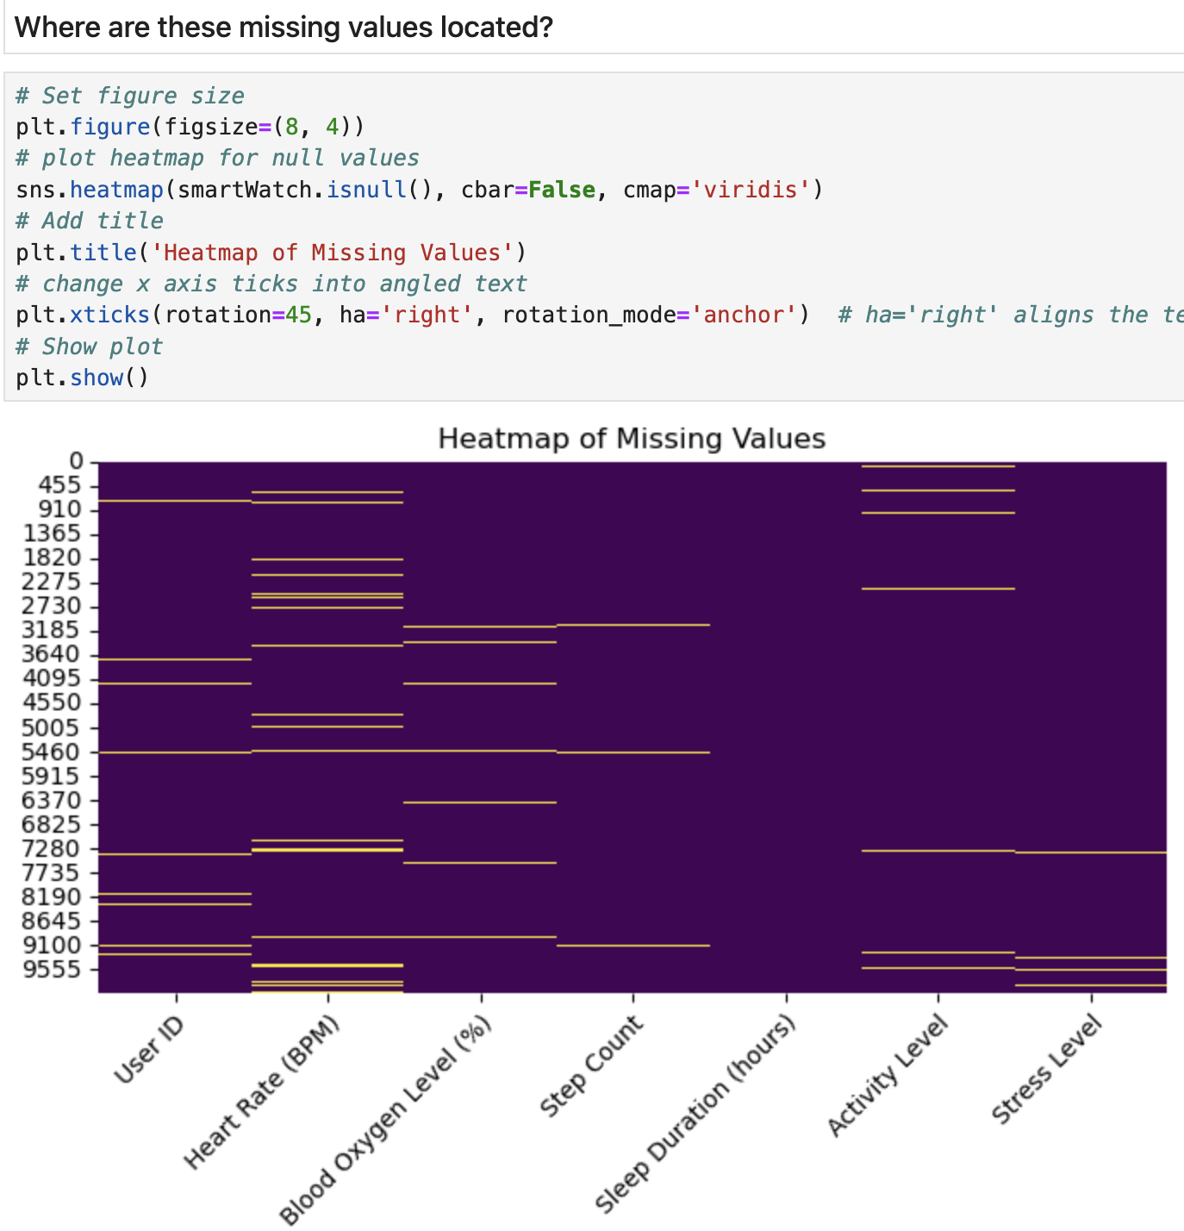
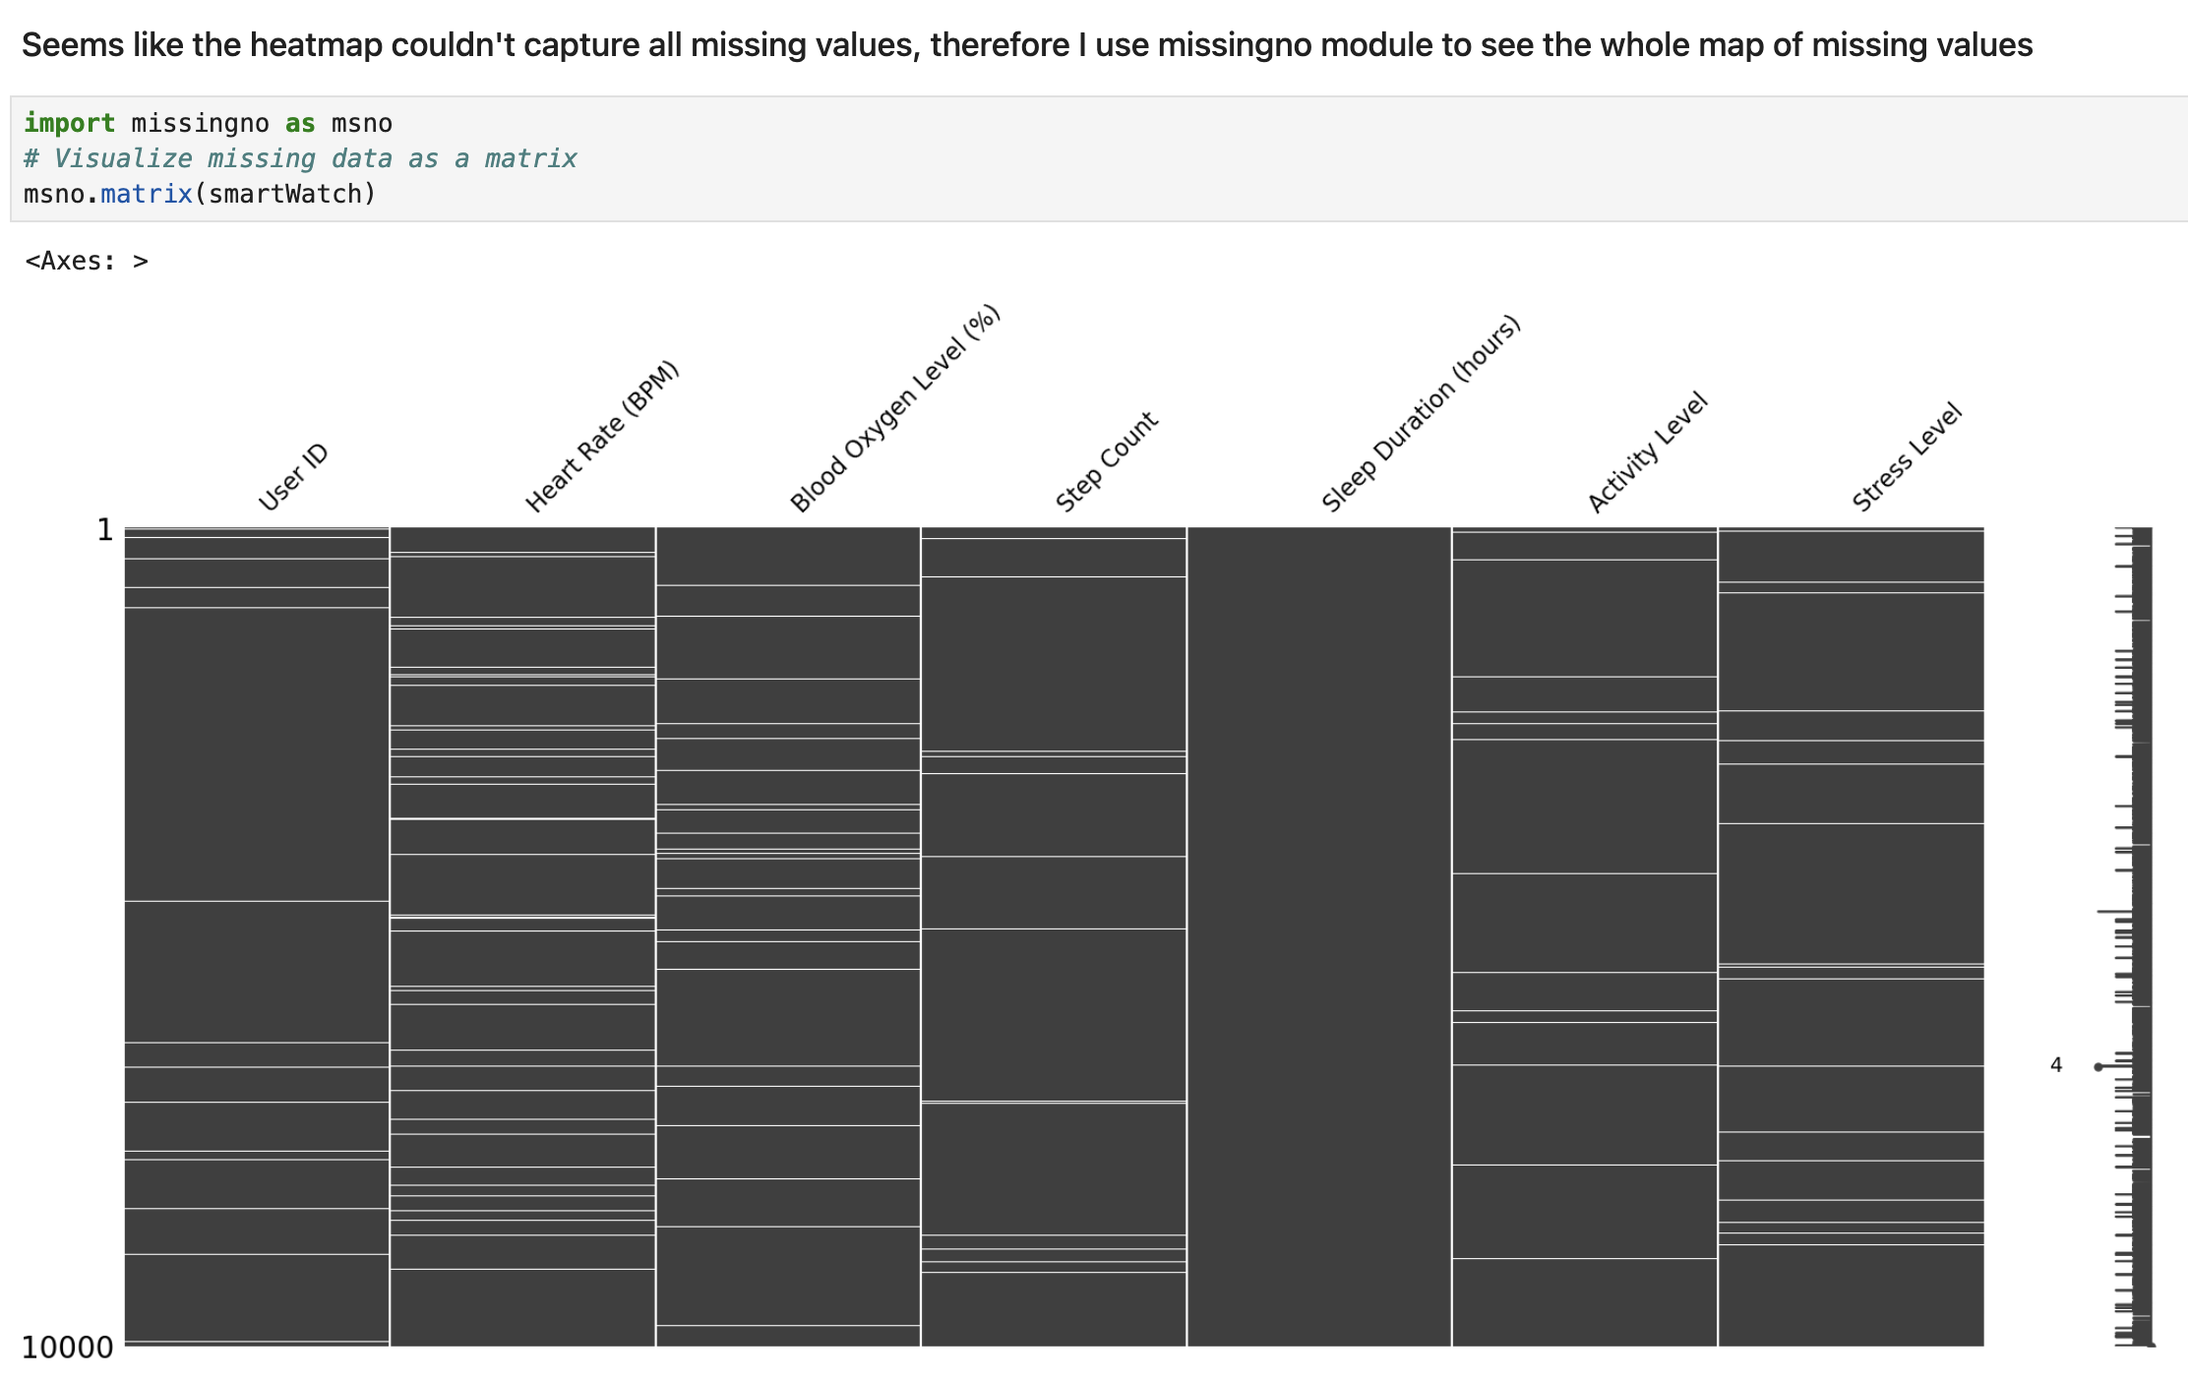
Missing Value

Slide 7
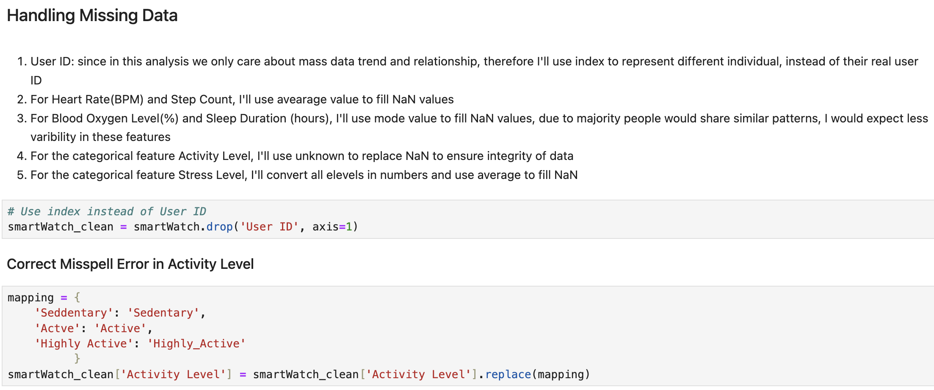
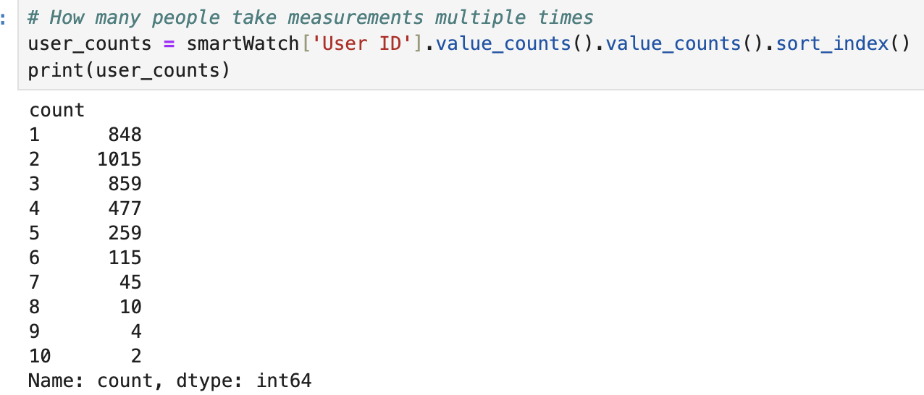
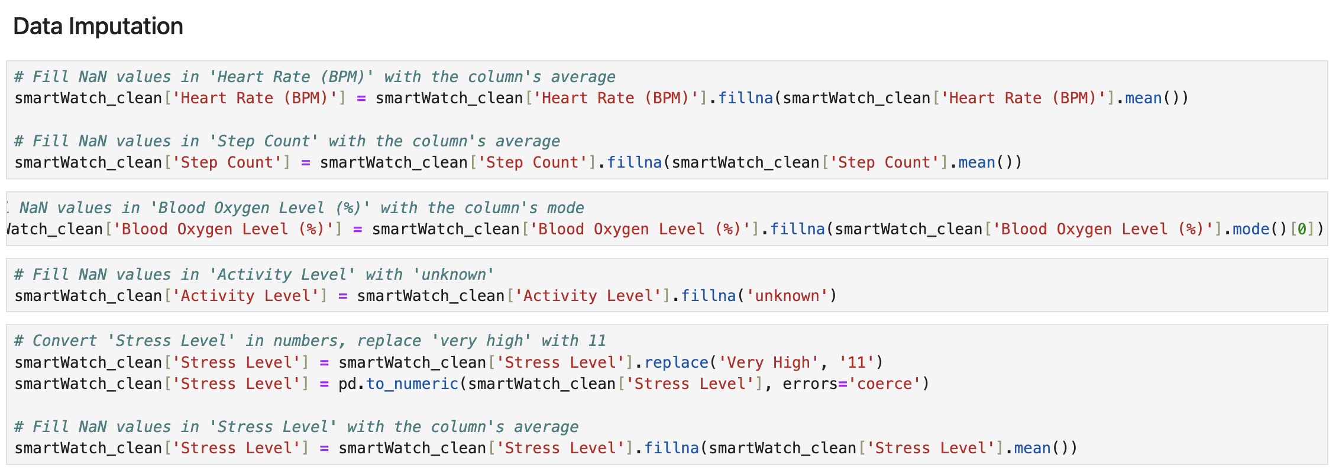
Data Imputation

Slide 8
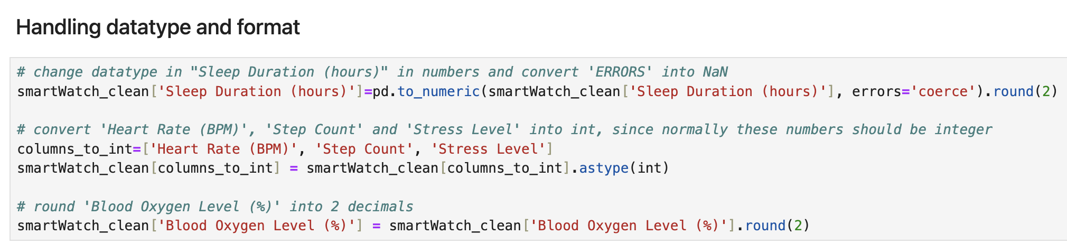
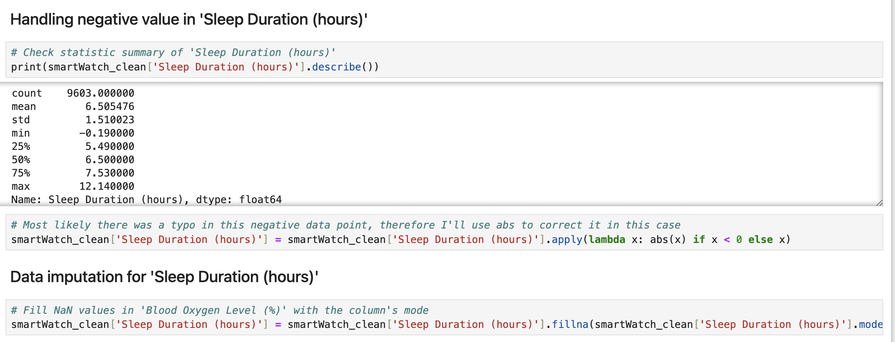
Data Imputation

Slide 9
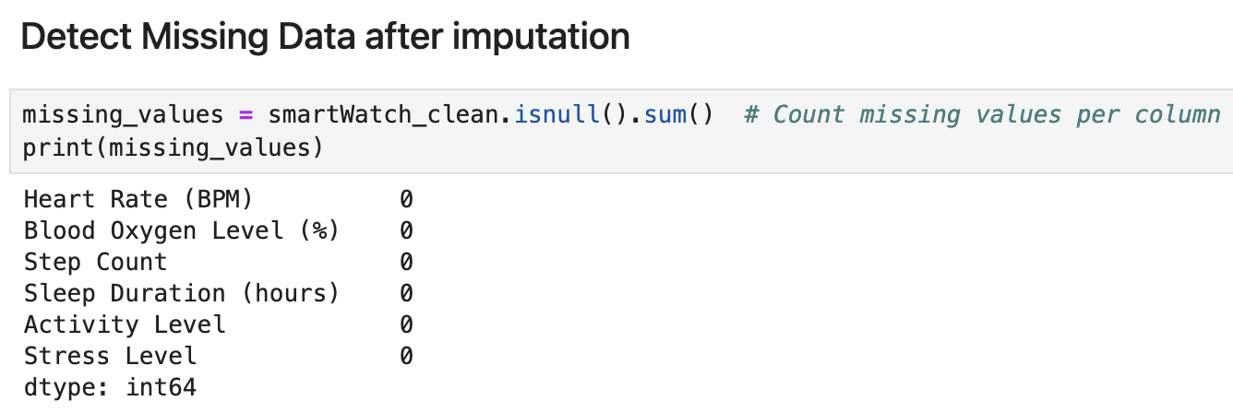
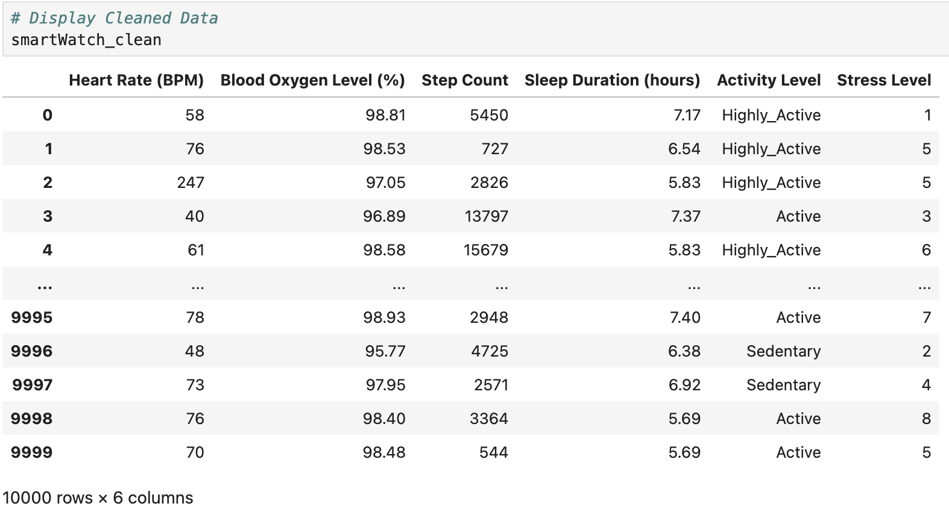
Data after Imputation

Slide 10
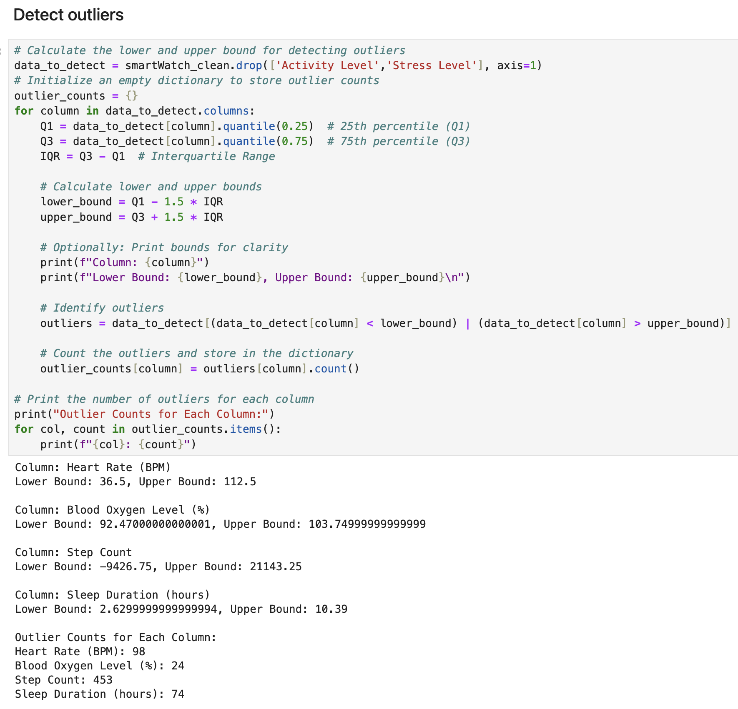
Detect outliers

Slide 11
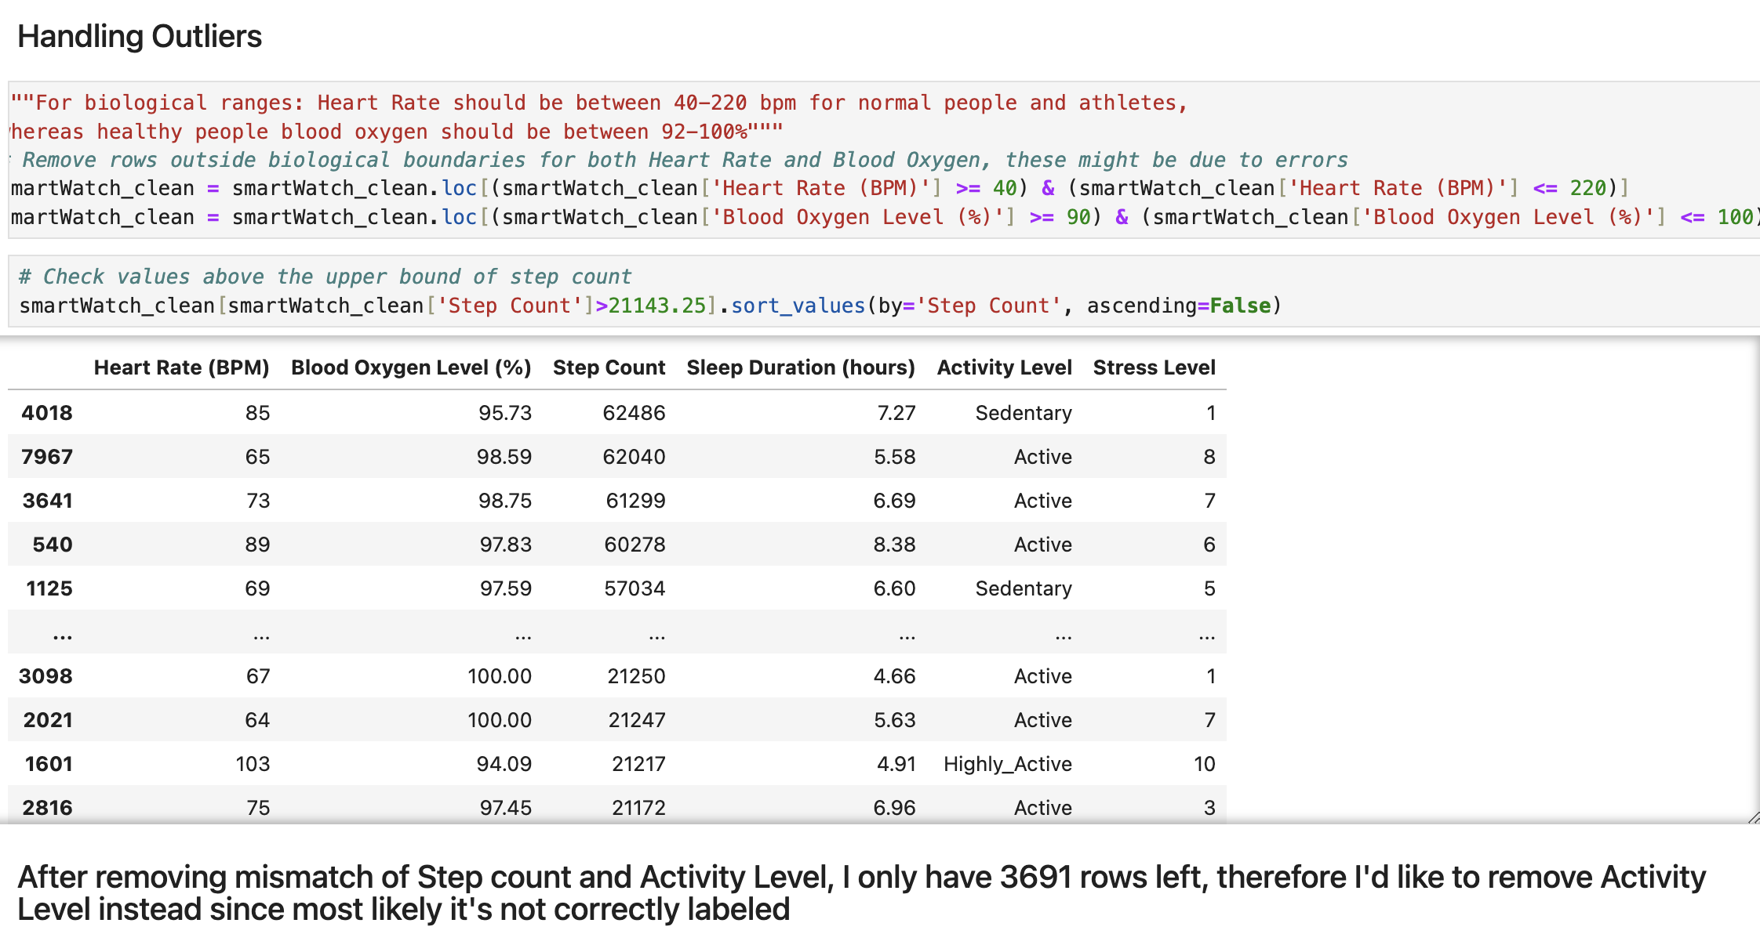
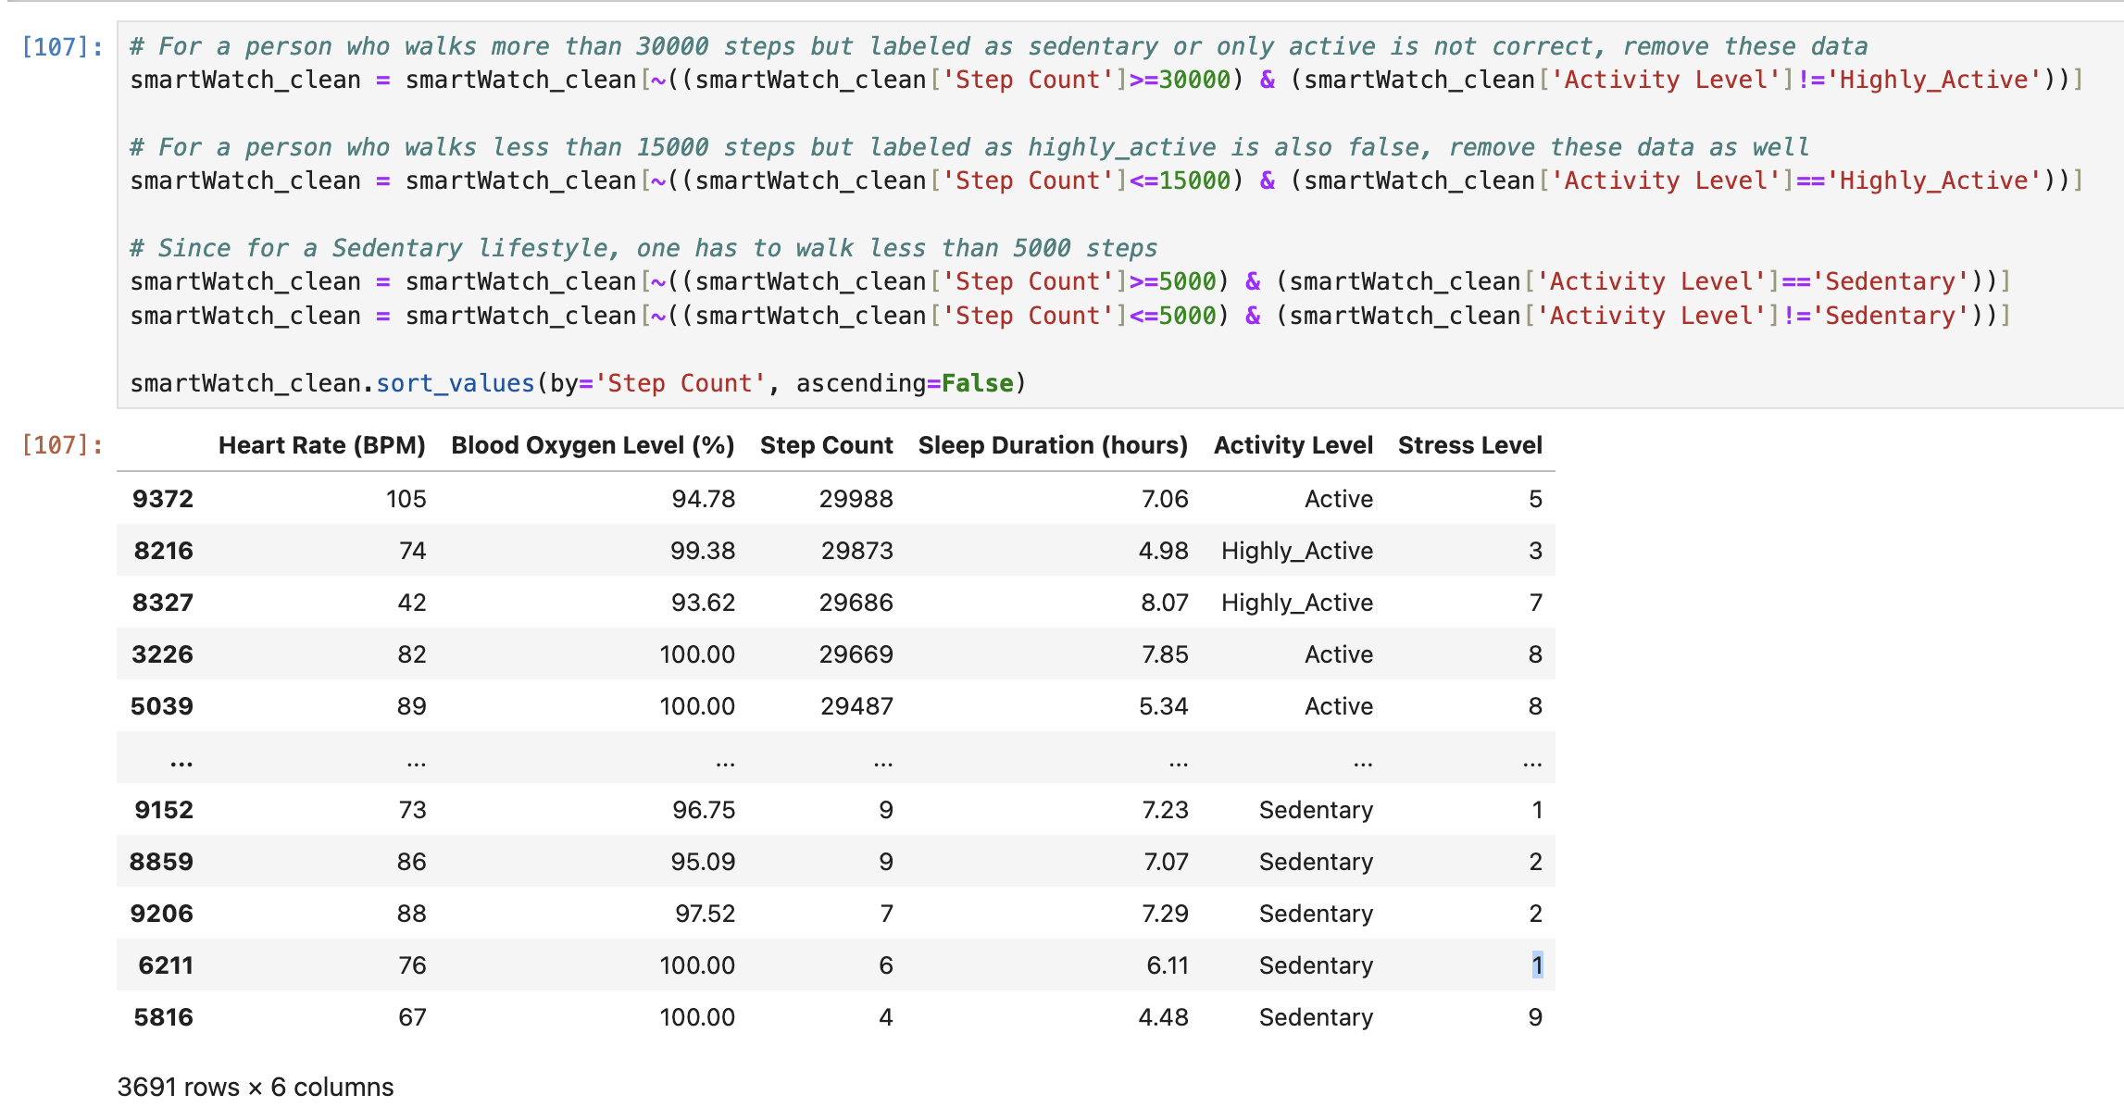
Handling outliers
Notes:
Step count outliers 449 rows

Slide 12
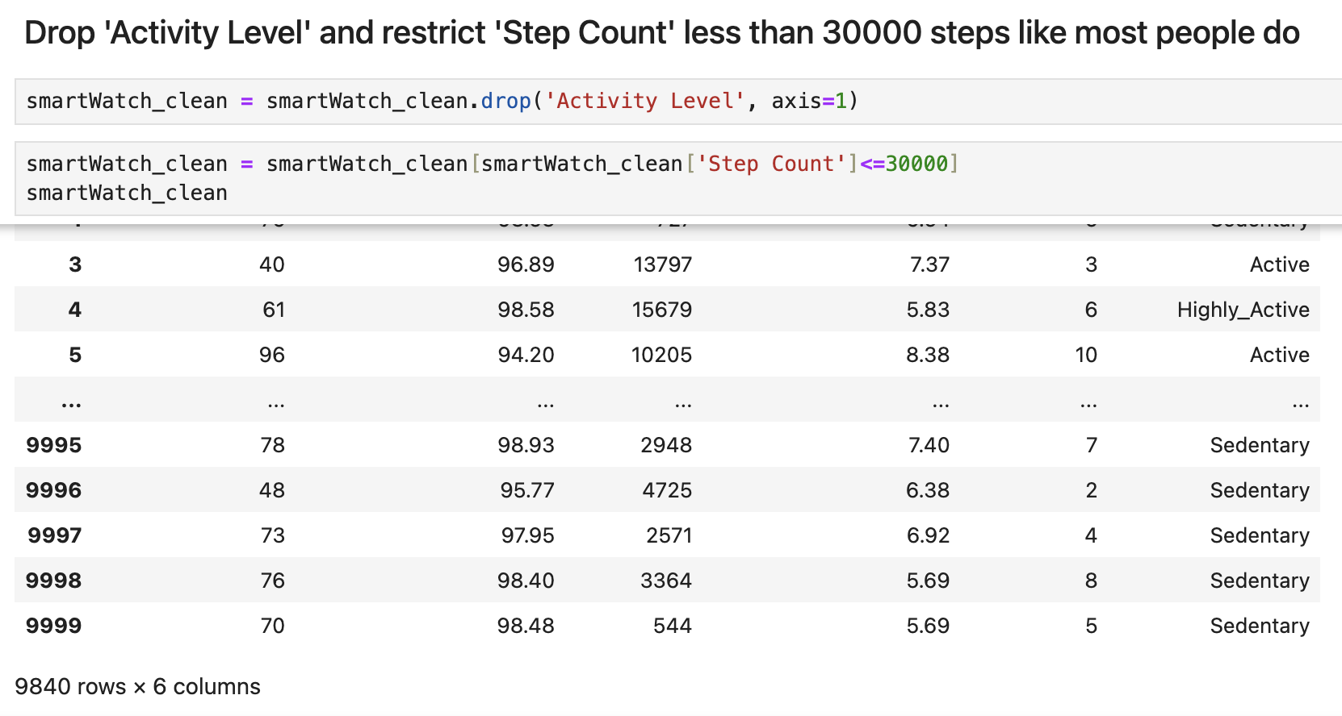
Handling outliers

Slide 13

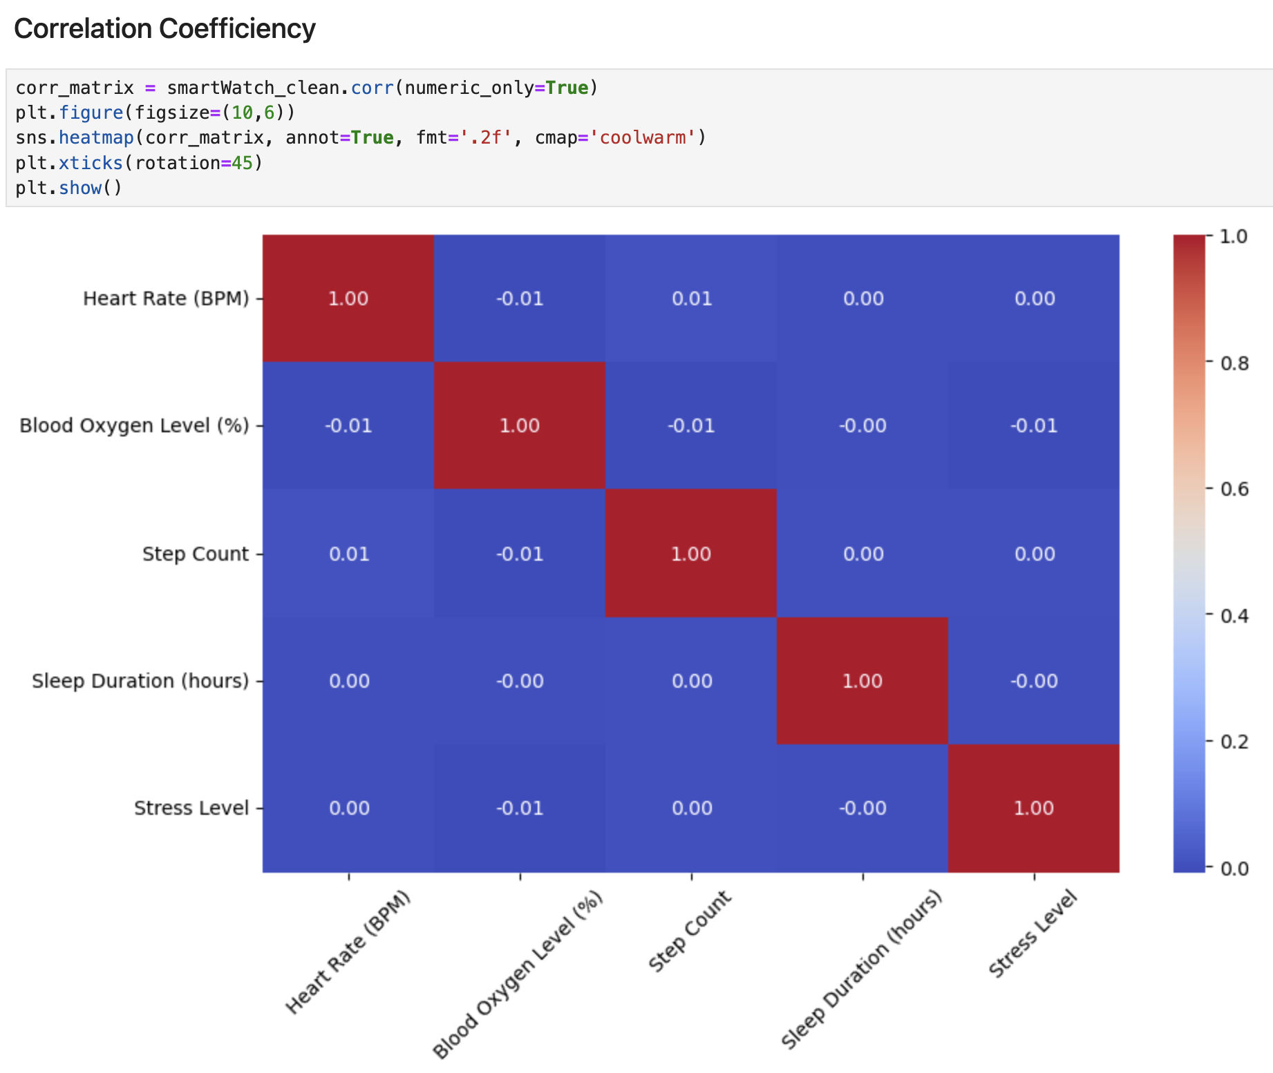
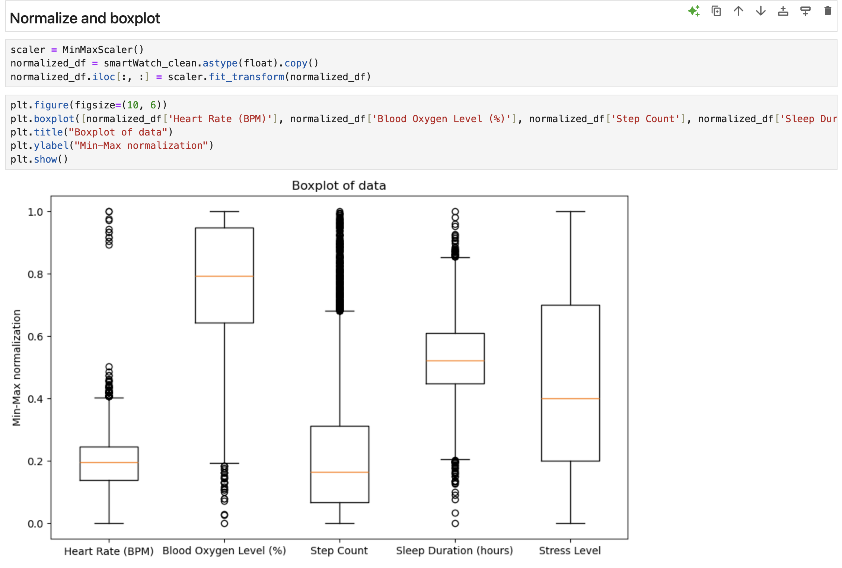
Visualization
Notes:
All the variables have been Min-Max normalized, meaning their values are scaled between 0 and 1. The median (middle line in the box) is around 0.2, meaning heart rates are generally closer to the minimum observed value.
There are outliers below the lower whisker, indicating some individuals have unusually low heart rates compared to the majority. The median is high, around 0.8, showing that most blood oxygen values are closer to the maximum observed value (as expected in healthy individuals). There are outliers below the lower whisker, which could represent instances of low blood oxygen levels, possibly linked to health issues. There are many outliers above the upper whisker, suggesting a few individuals are taking significantly more steps (e.g., highly active individuals). The median is around 0.5, with a wide IQR (spread of the box), showing that stress levels vary widely across the dataset.
There are fewer outliers compared to other variables, suggesting a more even distribution.

Slide 14
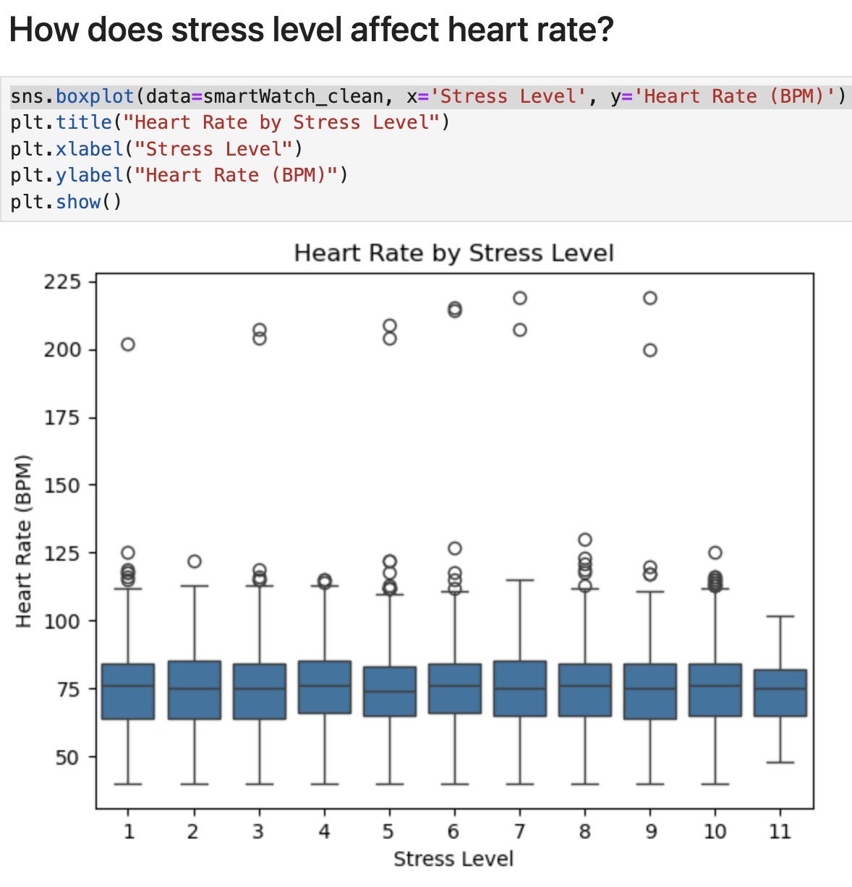
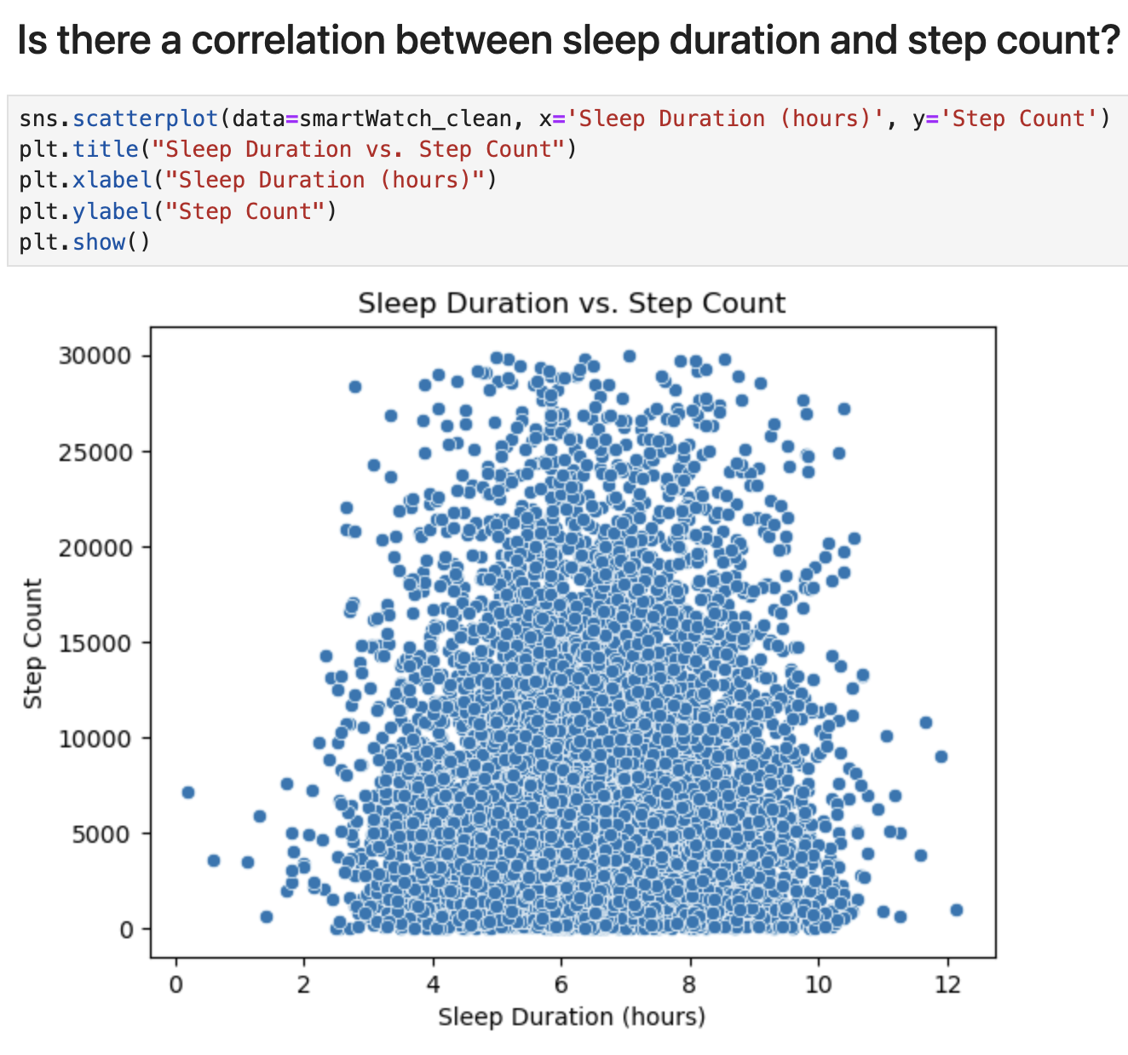
Visualization

Slide 15
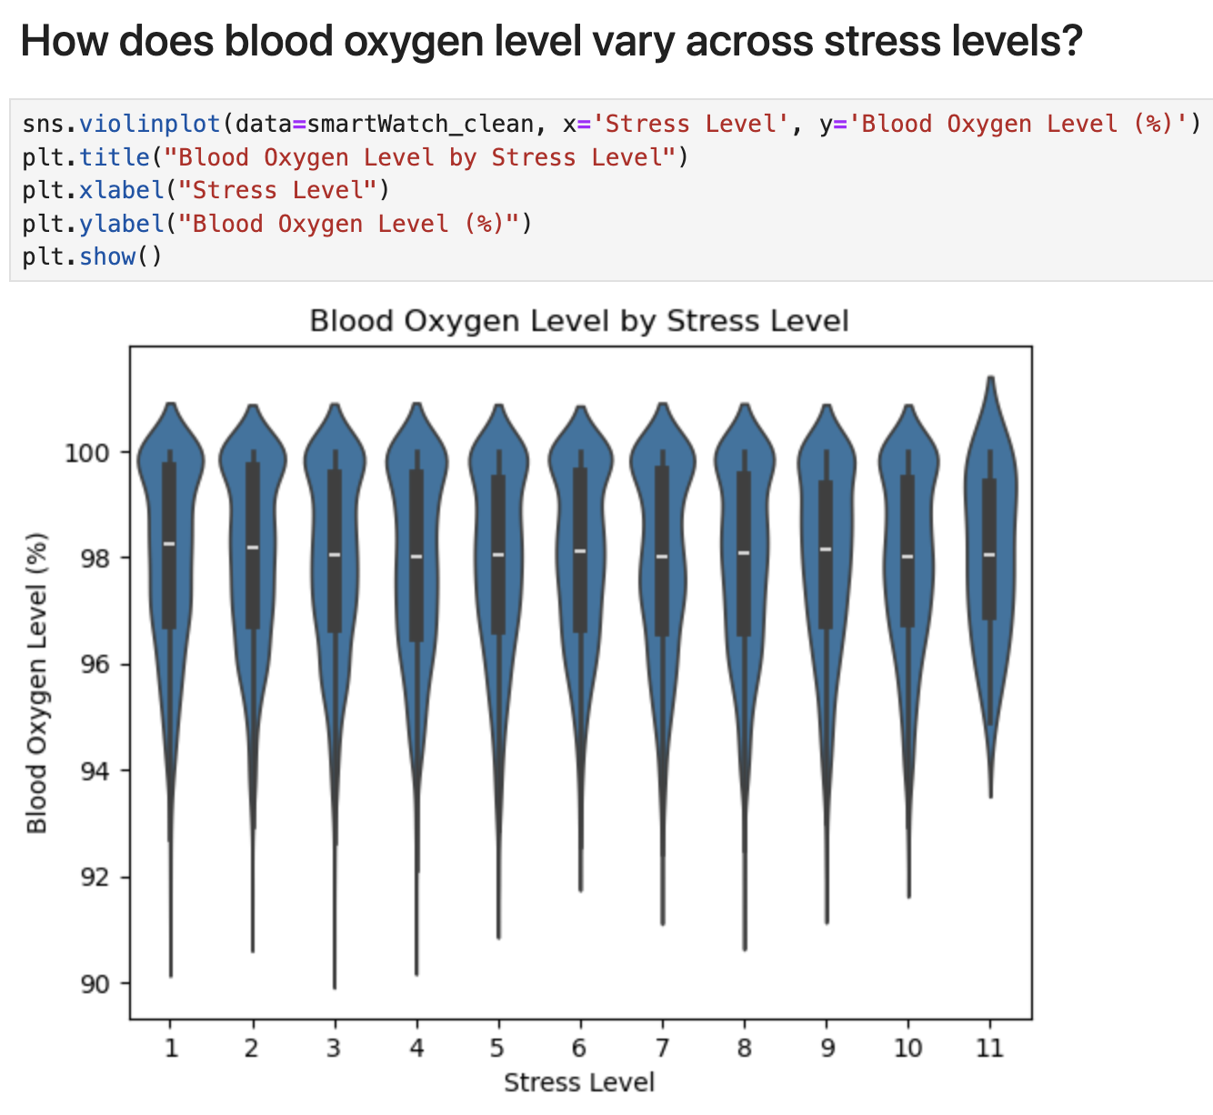
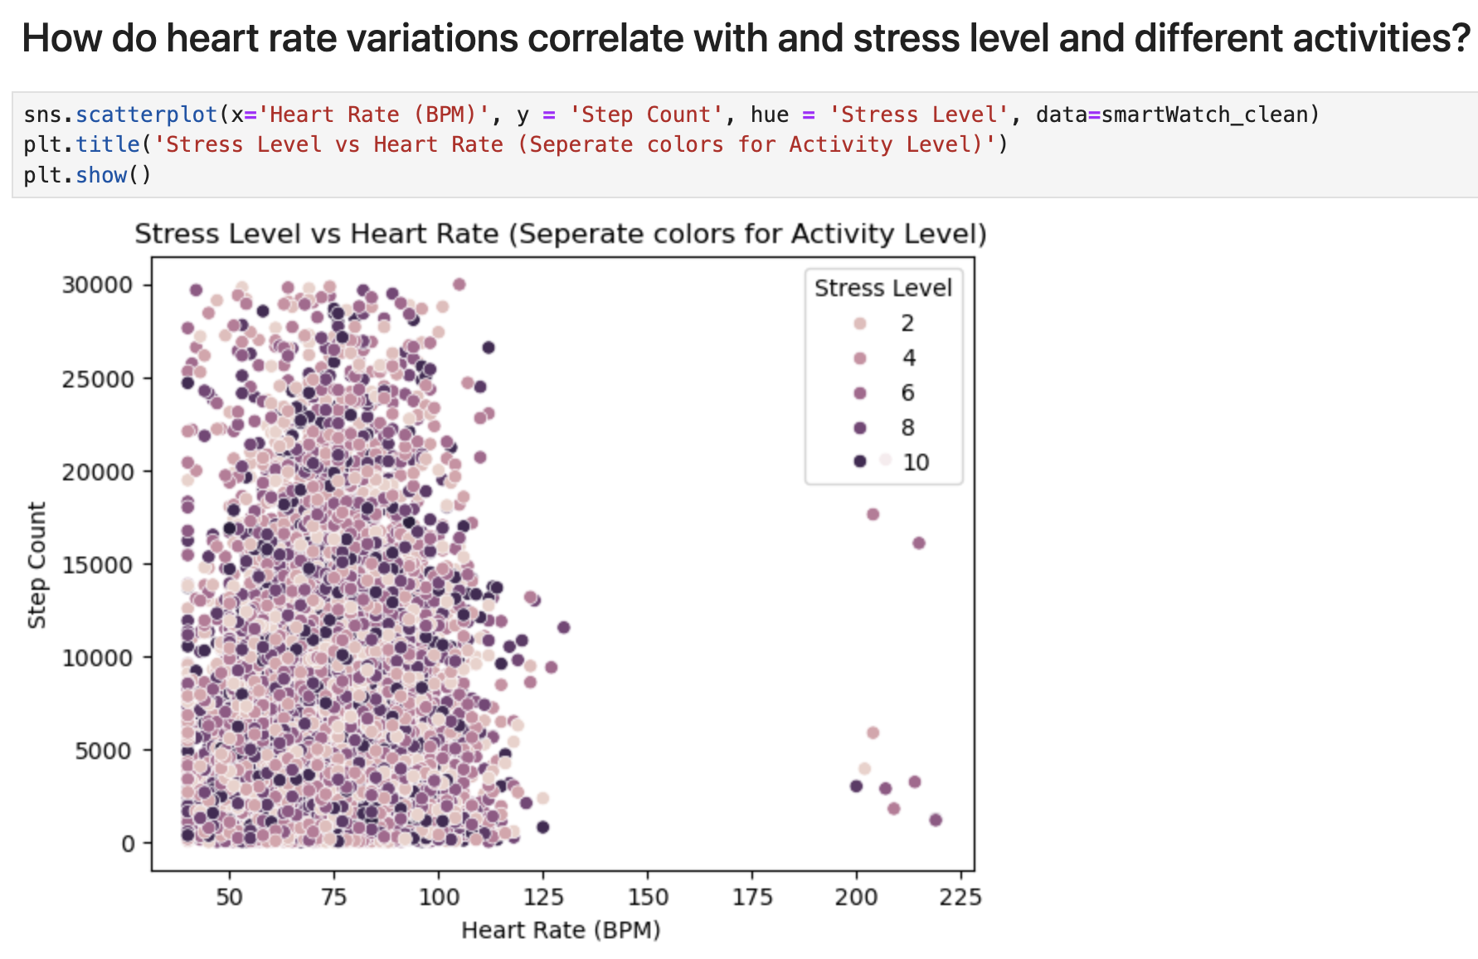
Visualization

Slide 16
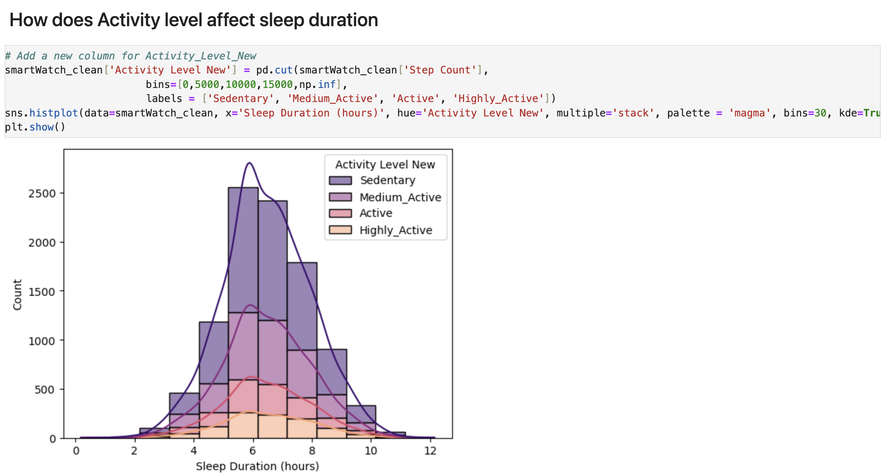
Visualization
Conclusions:
There’s no visible correlation between any two variables in this dataset
There’re a few individuals’ heart rate above the higher bound 220, which might indicate a tachycardia condition
There’re a few individuals’ blood oxygen level below the lower bound 92, might indicate a health issue
It would be nice to have age and time series data in this dataset, which could help interpret better
Is Step Count correct recorded? Since there are values as single digits or toward 60000 steps

